Slide 1

Customer Shopping Behavior Analysis
Data-Driven Insights into Customer Spending Patterns

Slide 2

Project Overview
This project analyzes customer shopping behavior using transactional data from 3,900 purchases across various product categories. The goal is to uncover insights into spending patterns, customer segments, product preferences, and subscription behavior to guide strategic business decisions.
3,900 Purchases
18 Data Columns
5 Major Categories
Transactional data analyzed
Comprehensive data points
Demographics, Purchase Details, Shopping Behavior, Subscription Status, Shipping

Slide 3

Dataset Summary
This dataset comprises 3,900 rows and 18 columns, providing a comprehensive view of customer shopping behavior. It includes key features across demographics, purchase details, and shopping patterns, offering a rich foundation for in-depth analysis.
CUSTOMER DEMOGRAPHICS
Age
Gender
Location
Subscription Status
PURCHASE DETAILS
Item Purchased
Category
Purchase Amount
Season
Size
Color
SHOPPING BEHAVIOR
Discount Applied
Promo Code Used
Previous Purchases
Frequency of Purchases
Review Rating
Shipping Type
Missing Data: 37 values in the Review Rating column.

Slide 4
Exploratory Data Analysis using Python
Data Loading
Initial Exploration
Missing Data Handling
Imported the dataset using pandas.
Used df.info() to check structure and .describe() for summary statistics.
Checked for null values and imputed missing values in the Review Rating column using the median rating of each product category.
Column Standardization
Feature Engineering
Data Consistency Check
Renamed columns to snake case for better readability and documentation.
Created age_group column by binning customer ages, Created purchase_frequency_days column from purchase data.
Verified if discount_applied and promo_code_used were redundant; dropped promo_code_used.
Database Integration
Connected Python script to PostgreSQL and loaded the cleaned DataFrame into the database for SQL analysis.

Slide 5
Data Analysis using SQL (Business Transactions)
Revenue by Gender
High-Spending Discount Users
Top 5 Products by Rating
Female: $75,191
839 customers who used discounts but spent above average.
Gloves: 3.86
Male: $157,890
Sandals: 3.84
Boots: 3.82
Hat: 3.80
Skirt: 3.78
Shipping Type Comparison
Subscribers vs Non-Subscribers
Standard: $58.46 avg
Express: $60.48 avg
Subscribers: 1,053 customers, $59.49 avg spend
Non-Subscribers: 2,847 customers, $59.87 avg spend

Slide 6
Key Findings
Discount-Dependent Products
Customer Segmentation
Hat: 50.00%
Loyal: 3,116 customers
Sneakers: 49.66%
New: 83 customers
Coat: 49.07%
Returning: 701 customers
Sweater: 48.17%
Pants: 47.37%
Revenue by Age Group
Repeat Buyers & Subscriptions
Young Adult: $62,143
Non-repeat buyers with subscriptions: 2,518
Middle-aged: $59,197
Repeat buyers (>5 purchases) with subscriptions: 958
Adult: $55,978
Senior: $55,763

Slide 7
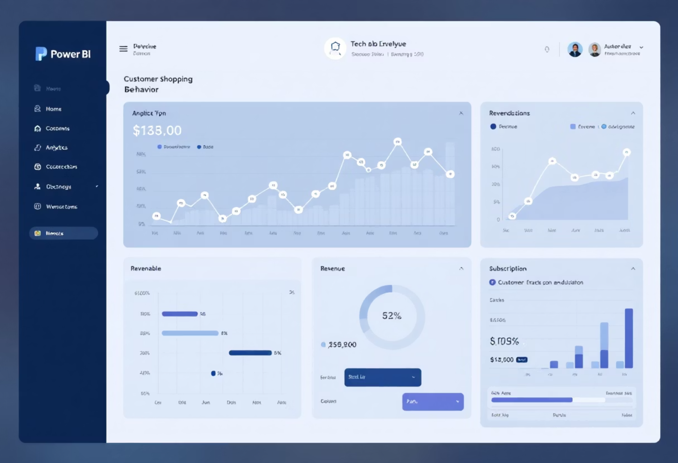
Interactive Dashboard in Power BI
Finally, we built an interactive dashboard in Power BI to present insights visually.
3.9K
$59.76
3.75
Number of Customers
Average Purchase Amount
Average Review Rating
The dashboard includes interactive visualizations for:
Subscription Status breakdown (Yes 27%, No 73%)
Revenue by Category
Sales by Category
Revenue by Age Group
Sales by Age Group
Shipping Type filters

Slide 8
Strategic Recommendations
Boost Subscriptions
Customer Loyalty Programs
Review Discount Policy
Promote exclusive benefits for subscribers to increase subscription adoption and customer lifetime value.
Reward repeat buyers to move them into the "Loyal" segment and increase retention.
Balance sales boosts with margin control by analyzing discount effectiveness on profit margins.
Product Positioning
Targeted Marketing
Highlight top-rated and best-selling products in campaigns to maximize visibility and sales.
Focus efforts on high-revenue age groups (Young Adults) and express-shipping users for better ROI.

